Slide 1
English Wikipedia
Data Analysis
Vani Hovale

Slide 2
Introduction
Wikipedia offers rich set of data that is easily and readily available for data scientists. The data from Wiki can be used to practice the science of Big Data Analytics

Slide 3
Technology Used
On my personal laptop I installed Hive. All the data was downloaded using WSL command line wget and loaded into Hive db.
HQL was used to query data.

Slide 4
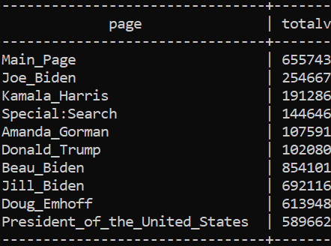
Q1.Which English wikipedia article got the most traffic on January 20, 2021?
Main Page with totalviews 6557430 got most traffic on Jan 20, 2021
Query Used: select page, sum(viewcount) as totalViews from pageview2 group by page order by totalViews desc limit 10;

Slide 5
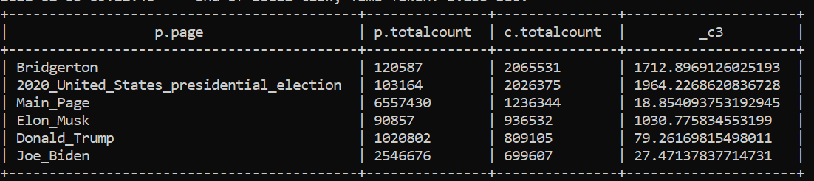
Q2.What English wikipedia article has the largest fraction of its readers follow an internal link to another wikipedia article?
create table clickstreamPrevCountSum ( prev string, totalCount int);
insert into clickstreamPrevCountSum (select prev, sum(count) as c from clickstream where type='link' group by prev order by c desc limit 100);
create table pageviewPageCountSum ( page string, totalCount int);
insert into pageviewPageCountSum (select page, sum(viewCount) as c from pageview2 group by page order by c desc limit 100);
select p.page, p.totalCount , c.totalCount, c.totalCount/p.totalCount * 100 from pageviewPageCountSum p inner join clickstreamPrevCountSum c on p.page=c.prev
ClickStream
PageView
Notes:
I first created a table for click stream. It contains top 100 referrer pages in wiki. This is numberator. The denominator is the pageview data. The ratio will give the top retainer pages in wiki. My pageview data is for jan 20. Click stream data is Dec 2020. Hence data is skewed. Once correct data is loaded, it will show accurate results.

Slide 6
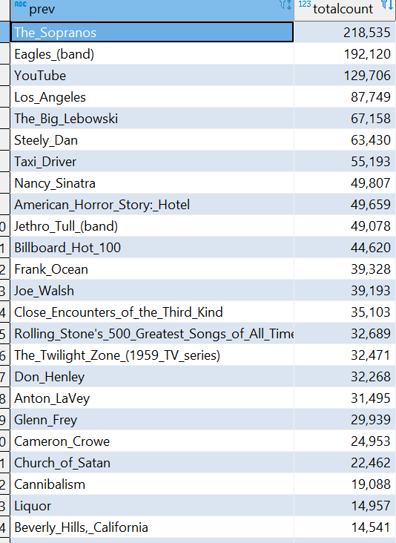
Q#3.What series of wikipedia articles, starting with
[Hotel California](https://en.wikipedia.org/wiki/Hotel_California), keeps the largest fraction of its readers clicking on internal links?
The Sopranos had most retention after it was referred by Hotel_California
Notes:
This is similar to previous question. The additional part is that the click stream table contains top 100 pages that were referred by Hotel_California page. Since my page view data is not loaded fully, this shows the top referrer page from Hotel California Page only.

Slide 7
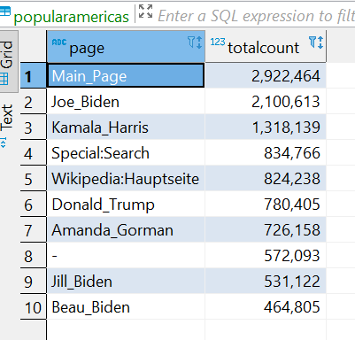
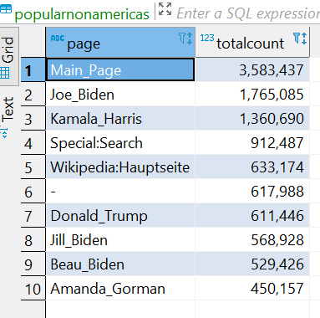
Find an example of an English wikipedia article that is relatively more popular in the Americas than elsewhere. There is no location data associated with the wikipedia pageviews data, but there are timestamps. You'll need to make some assumptions about internet usage over the hours of the day.
Notes:
I split the page view data on Jan 20, 2021 into two tables. Americans table for hours 9Am to 6 PM, remaining time Non-Americans. Query is same as Q1 query

Slide 8
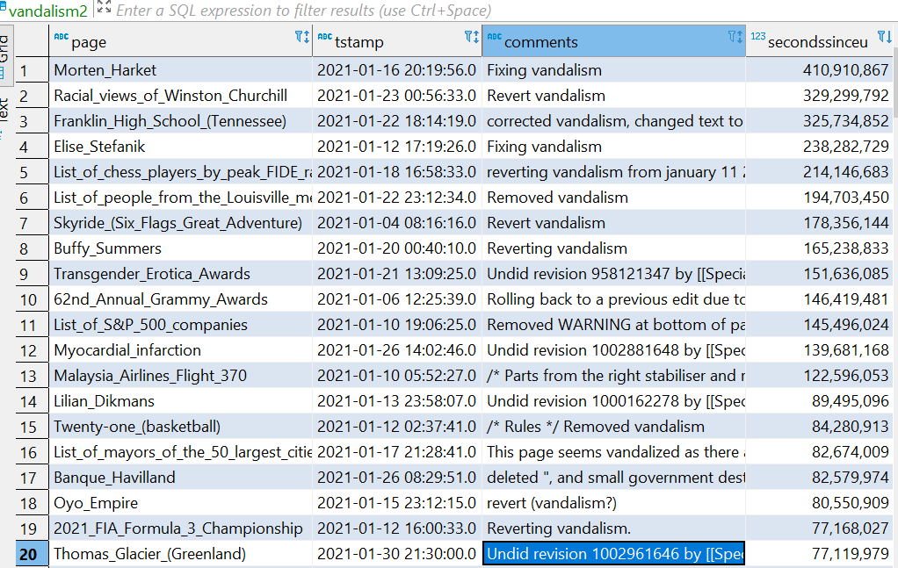
Analyze how many users will see the average vandalized wikipedia page before the offending edit is reversed.
Looking at the data, to find answer to this question would be hard. Morten Harket page took 13 YEARS to get fixed. This is just one day’s data (Jan 1, 2021). Finding count of pageviews for one page in 13 years will be hard.
Notes:
I loaded Wiki media data for jan 1, 20201 into table. Filtered the rows for comments like ‘%vandal%’ sorted the results by seconds it took to fix. Top page took 13 years to get fixed.

Slide 9
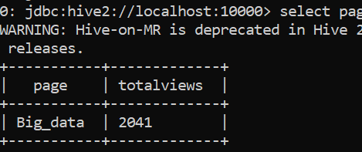
Run an analysis you find interesting on the wikipedia datasets we're using.
I found it interesting that people were reading Big_data wiki page on the day of the US presidential inauguration.

Slide 10
GIT REPO
https://github.com/vanisubodh

